Slide 1
Search for Exoplanets
Team ExoTerra
Thomas Dill
Brian haugen
Daniil Kernazhytski

Slide 2
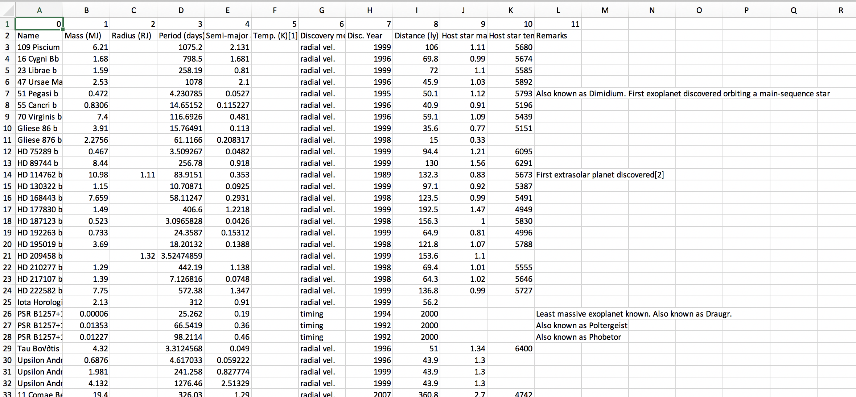
Our Data is drawn from Wikipedia: https://en.wikipedia.org/wiki/List_of_exoplanets_(full)

Slide 3
Indexing of the data
The data is delineated in a very technical form; Inverted indexing will be used
No stemming, stopping, or n-gamming will be utilized
The user will be given examples and typical search term queries

Slide 4
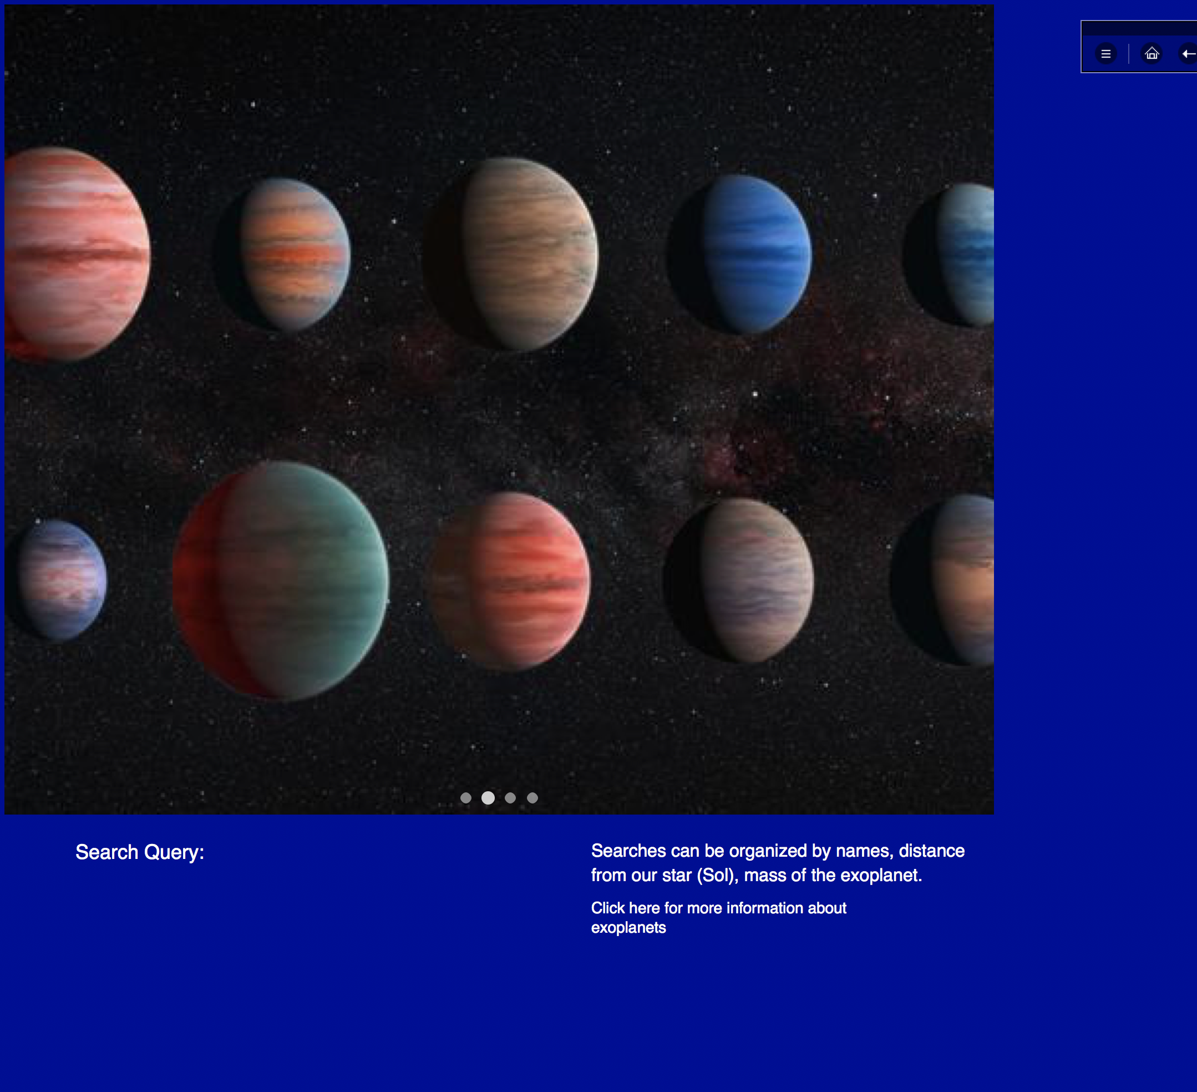
Web Page Mock UP

Slide 5
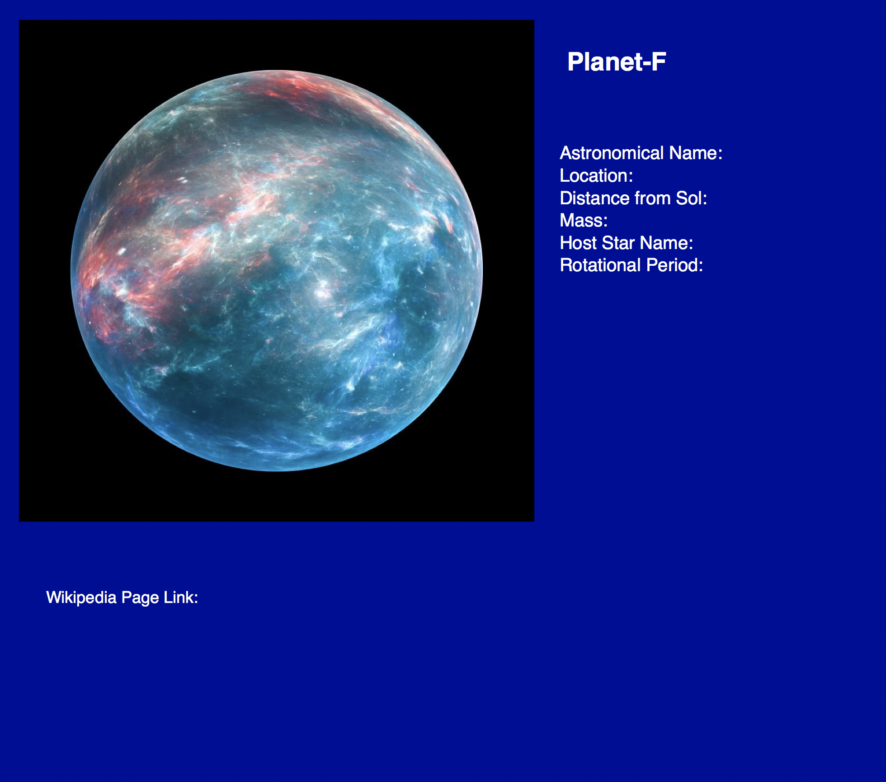
Web Page Mock UP

Slide 6
Features
#1: Searchable Database of Exoplanets
#2: Available images of planets
#3: Extra information about parent star
#4: Relevant Wikipedia pages

